Slide 1
Module A Reading and Writing

Slide 2
Adjectives
Order of Adjectives
Comparative and Superlative Degree
Articles, adverbs, pronouns.

Slide 3

Task 1
Study the description of the course of AIec Hammond, a technology student from Scotland, and answer the questions.
1 How long does the course last?
2 What jobs can he do after he completes this course?
3 Can he study a foreign language?

Slide 4
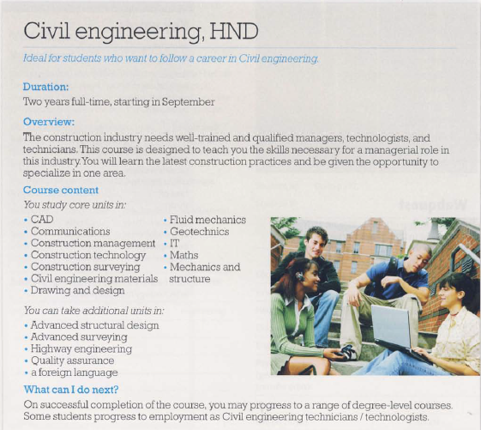
UTN FRVM Lic. Bibiana Fernandez

Slide 5
Task 2
Reading Comprehension
Read the following text and answer the questions
UTN FRVM Lic. Evangelina Cecchel Lic. Bibiana Fernandez

Slide 6
What is the difference between a technician, a technologist and an engineer?
What is the difference between a technician, a technologist and an engineer? The main difference is in the level of education and training. Engineers have the highest level of training and normally have university qualifications. A technologist usually has 2–3 years of training, and a technician usually has 1–2 years.
You can progress from technician to technologist and then to engineer by doing courses at college and university. Colleges offer certificates and diplomas (a diploma is a higher qualification than a certificate). Universities offer degrees.
As an example, in the UK, young people who want a career in technology can start by studying at a college of further education or university. They normally follow the route: HNC (Higher National Certificate) → HND (Higher National Diploma) → B.Eng (Bachelor of Engineering degree). Some universities allow students to start a degree course after only one year of a diploma course. It is also possible for students to leave school at sixteen and work for a company. The company may allow them to study at a college for part of each week. This is called a part-time, day-release or ‘sandwich’ course. (See next page)
UTN FRVM Lic. Evangelina Cecchel Lic. Bibiana Fernandez

Slide 7
There is an example of a student, Alec, who is doing an HND diploma course in civil engineering at a college in Scotland. Civil engineers work in the planning and construction of airports, bridges, roads, etc. The course includes the following subjects:
• Construction surveying :This teaches how to measure ground and how to mark out lines and
points on the ground from plans.
• Construction management: This teaches how to ensure that building work is completed on time, safely and with the correct materials.
• Fluid mechanics: This teaches how liquids and gases move and affect structures. This is important in constructing pipelines, for example.
• Geotechnics: This is about the properties of earth and rocks. This is especially important in
underground construction.
• Communications (sometimes called complex communication, or communication skills): This
teaches how to speak and write about technical matters.
• CAD (Computer-Assisted Design): Surveyors and architects use computer software to help them draw plans and designs.
UTN FRVM Lic. Evangelina Cecchel Lic. Bibiana Fernandez

Slide 8
1 What is the main topic of this text?
a jobs in technology
b universities
c training for technology
d construction
2 Compare the length of studies of technologists and technicians.
3 How can technicians become engineers?
4 Which qualification is below a diploma?
5 Which course can you do while you are in a job?
6 Construction managers must ensure work is completed safely and correctly. What else?
7 Which part of the course is about explaining technical information to other people?
UTN FRVM Lic. Evangelina Cecchel Lic. Bibiana Fernandez

Slide 9
Task 3
Writing Assignment
You will find the assignment in the file corresponding to “Trabajo Práctico N° 1”
UTN FRVM Lic. Evangelina Cecchel Lic. Bibiana Fernandez

